Slide 1


Chargebee E-book
Concept pages

Slide 2
Brief
To design 6 pages + 2 cover pages that cover :
layout
iconography
colour palette
graphics
typography

Slide 3



Concept
UNIQUELY BOLD
The concept for this book was formulated keeping in mind that this collateral needs to stand apart in its sector through attractive imagery.
This was achieved through the play of several elements in the visual language.
Bold
Typo
graphy
Textured dots
Unique colour combinations
Flat illustrations
Playful layouts + use of white space
Bold typography

Slide 4

Cover pages
Concept 1 A play with graphic elements

Slide 5

Cover page

Slide 6
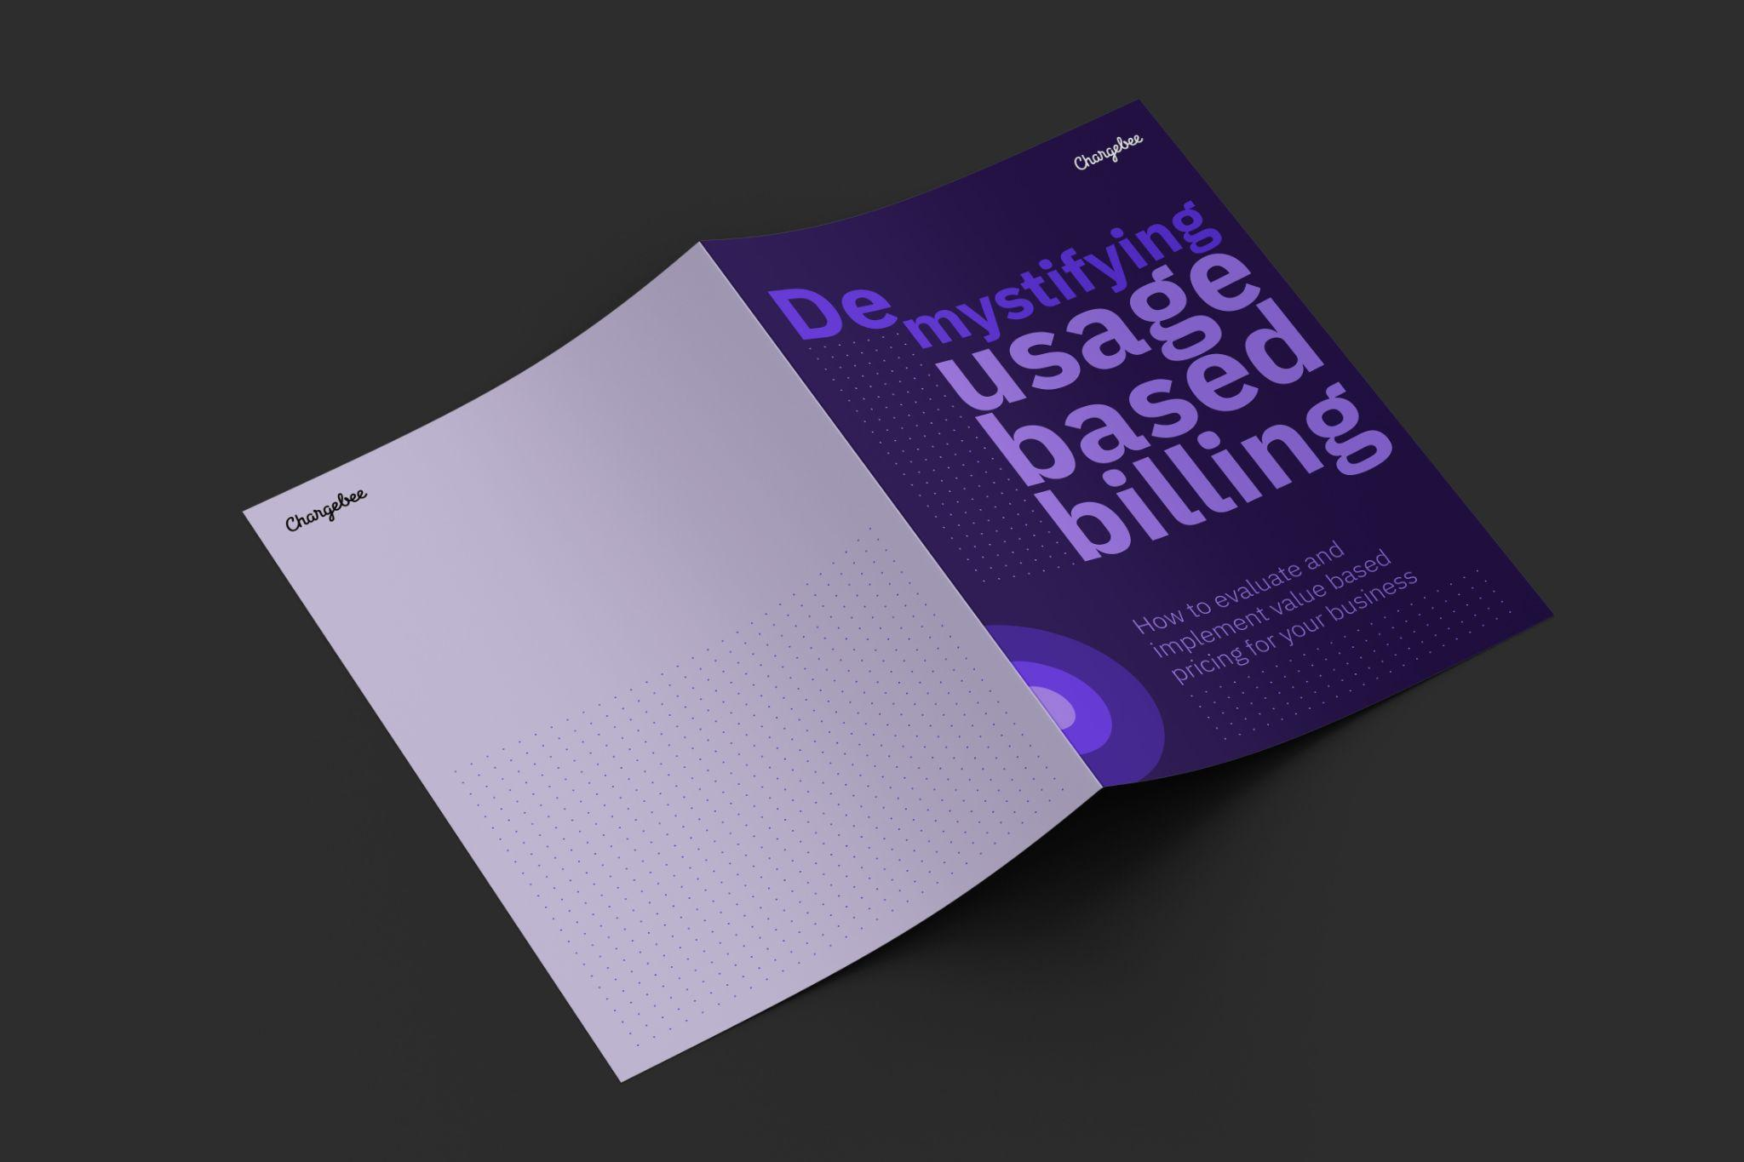
Cover page
Concept 2 A play with typography

Slide 7
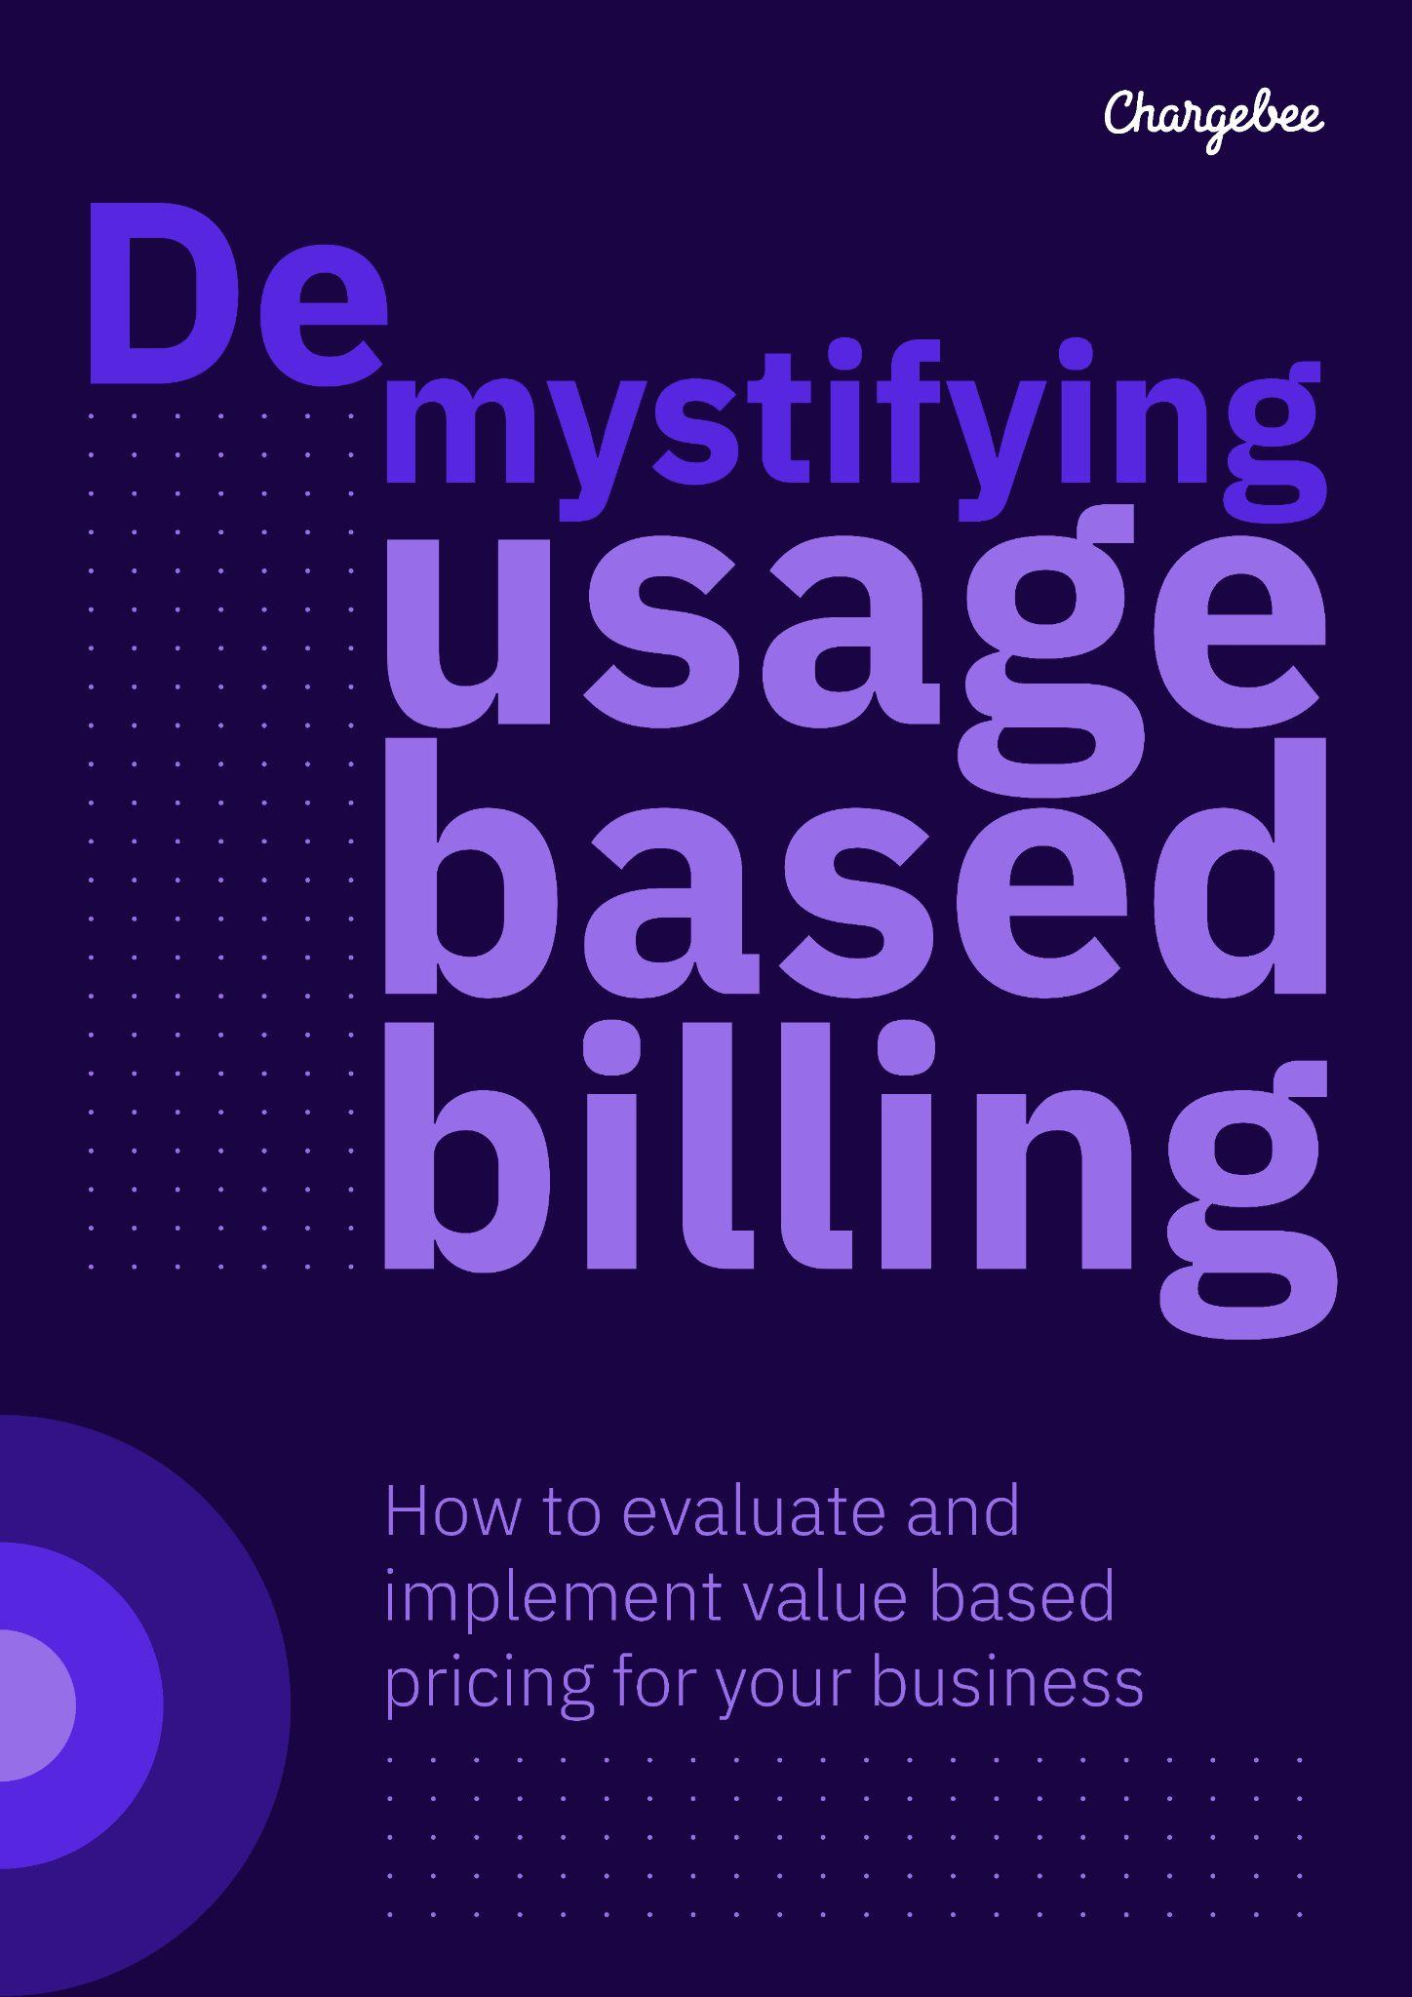
Cover pages

Slide 8

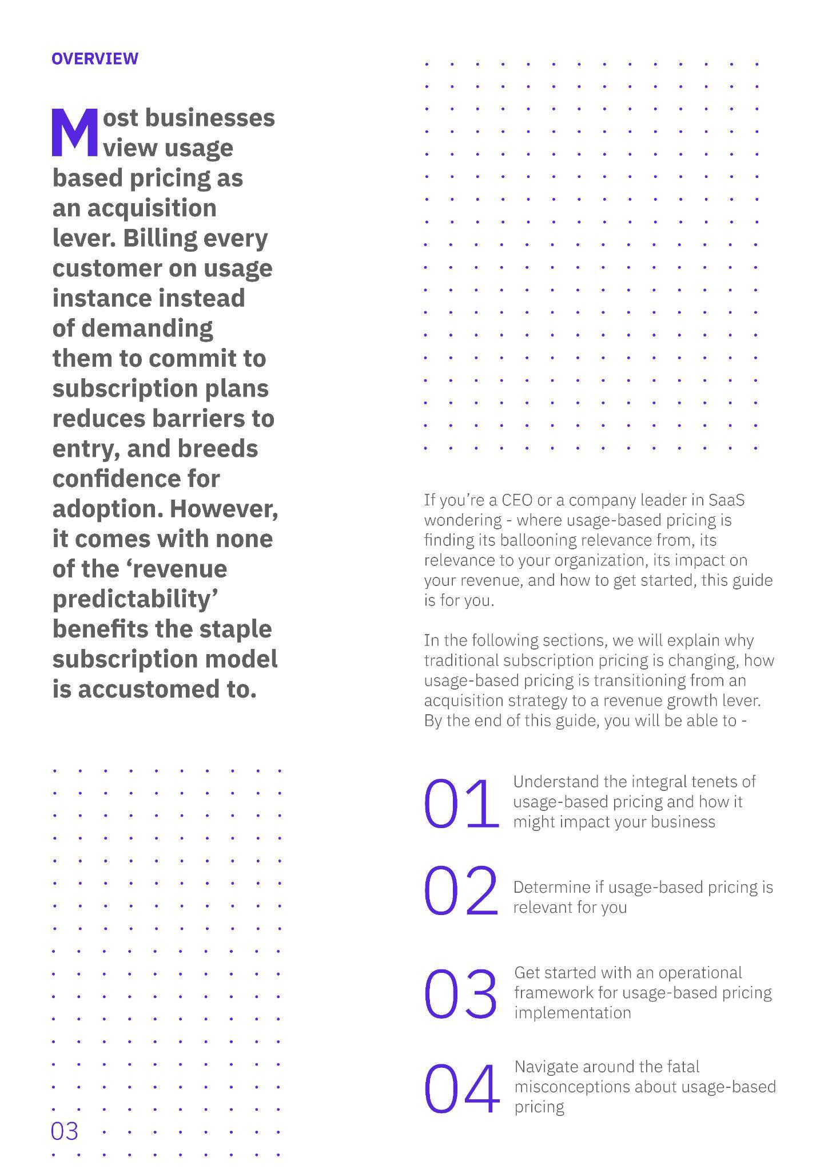
Inner pages
SECTION 1 : Overview

Slide 9
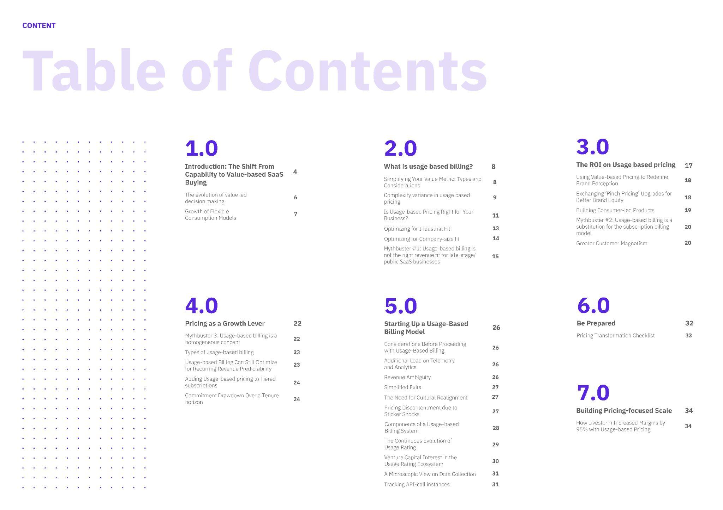
Inner pages
SECTION 2 : Table of contents

Slide 10

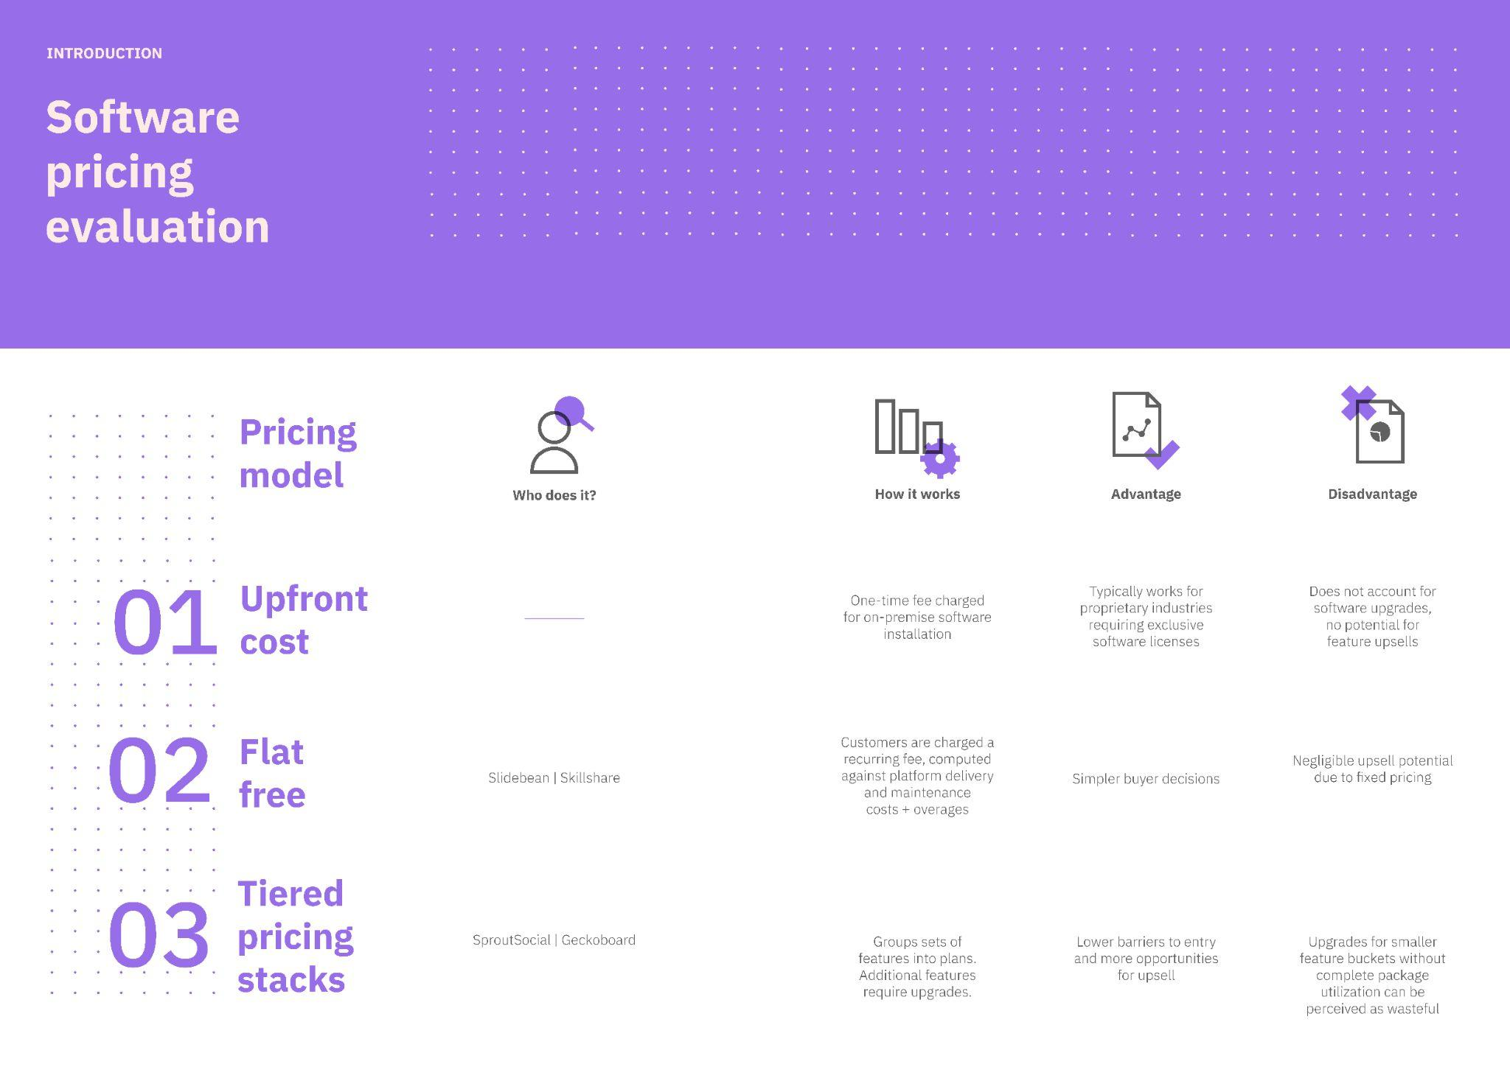
Inner pages
SECTION 3 : Introduction

Slide 11
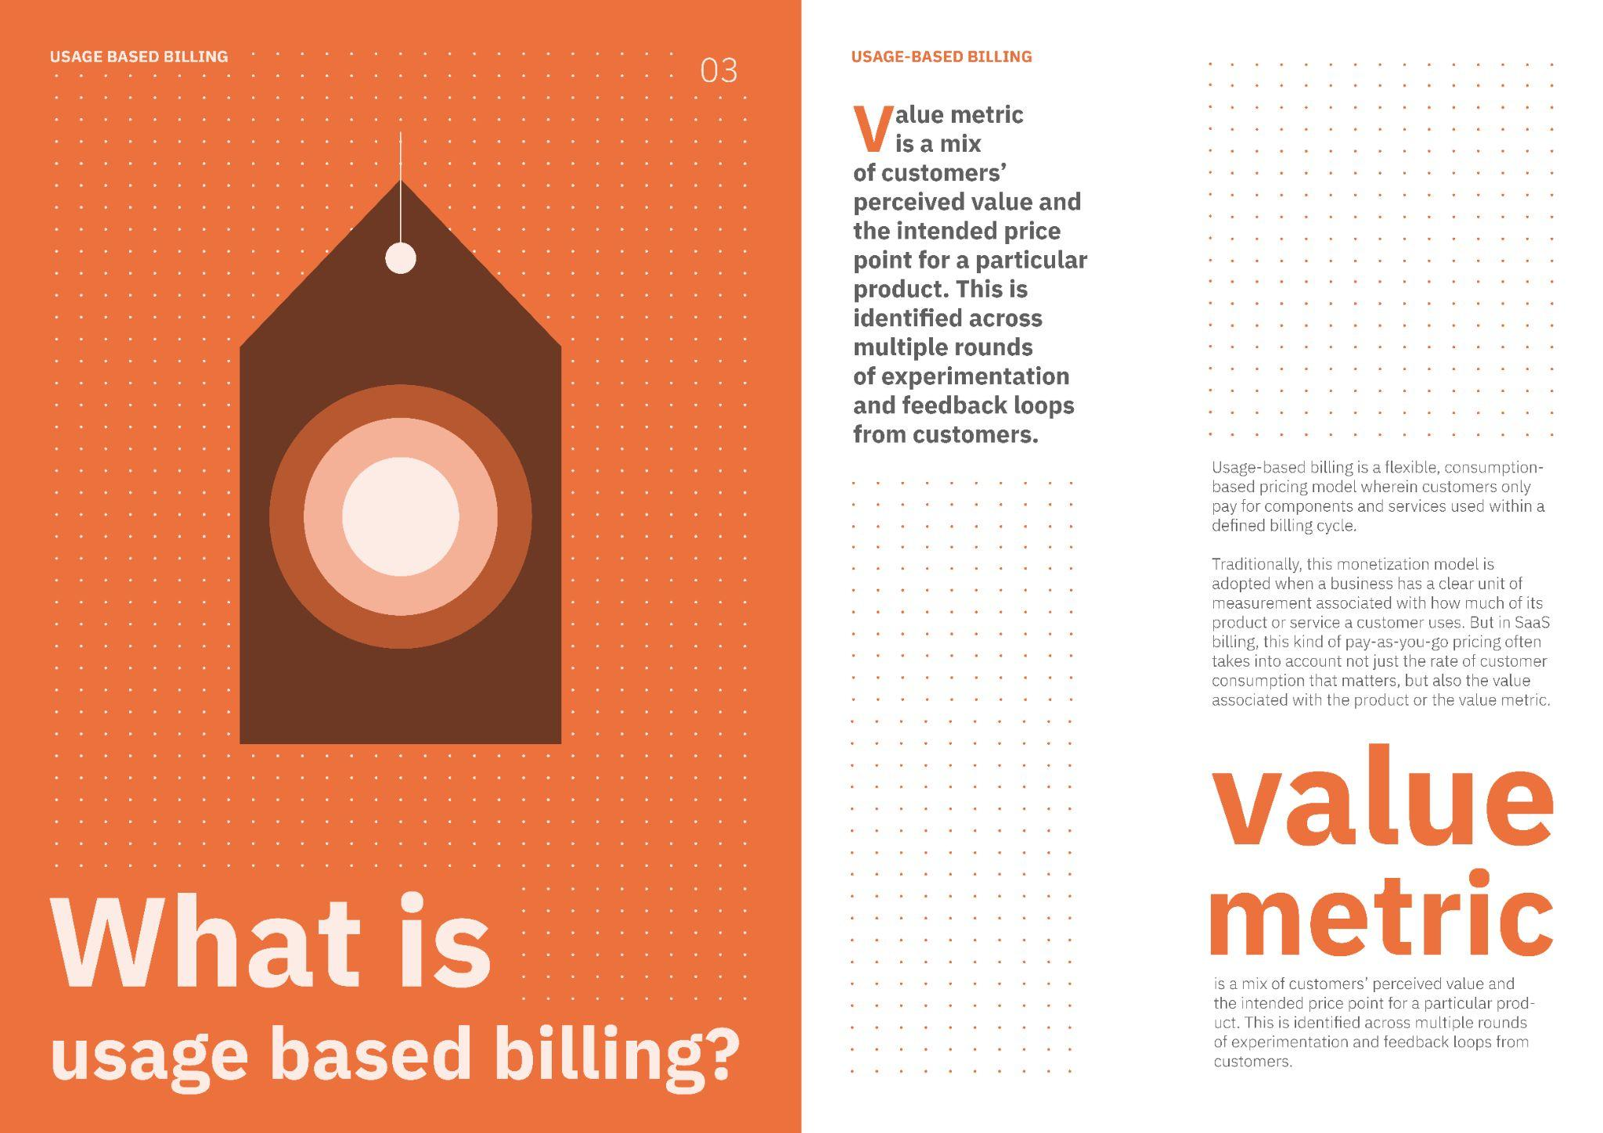
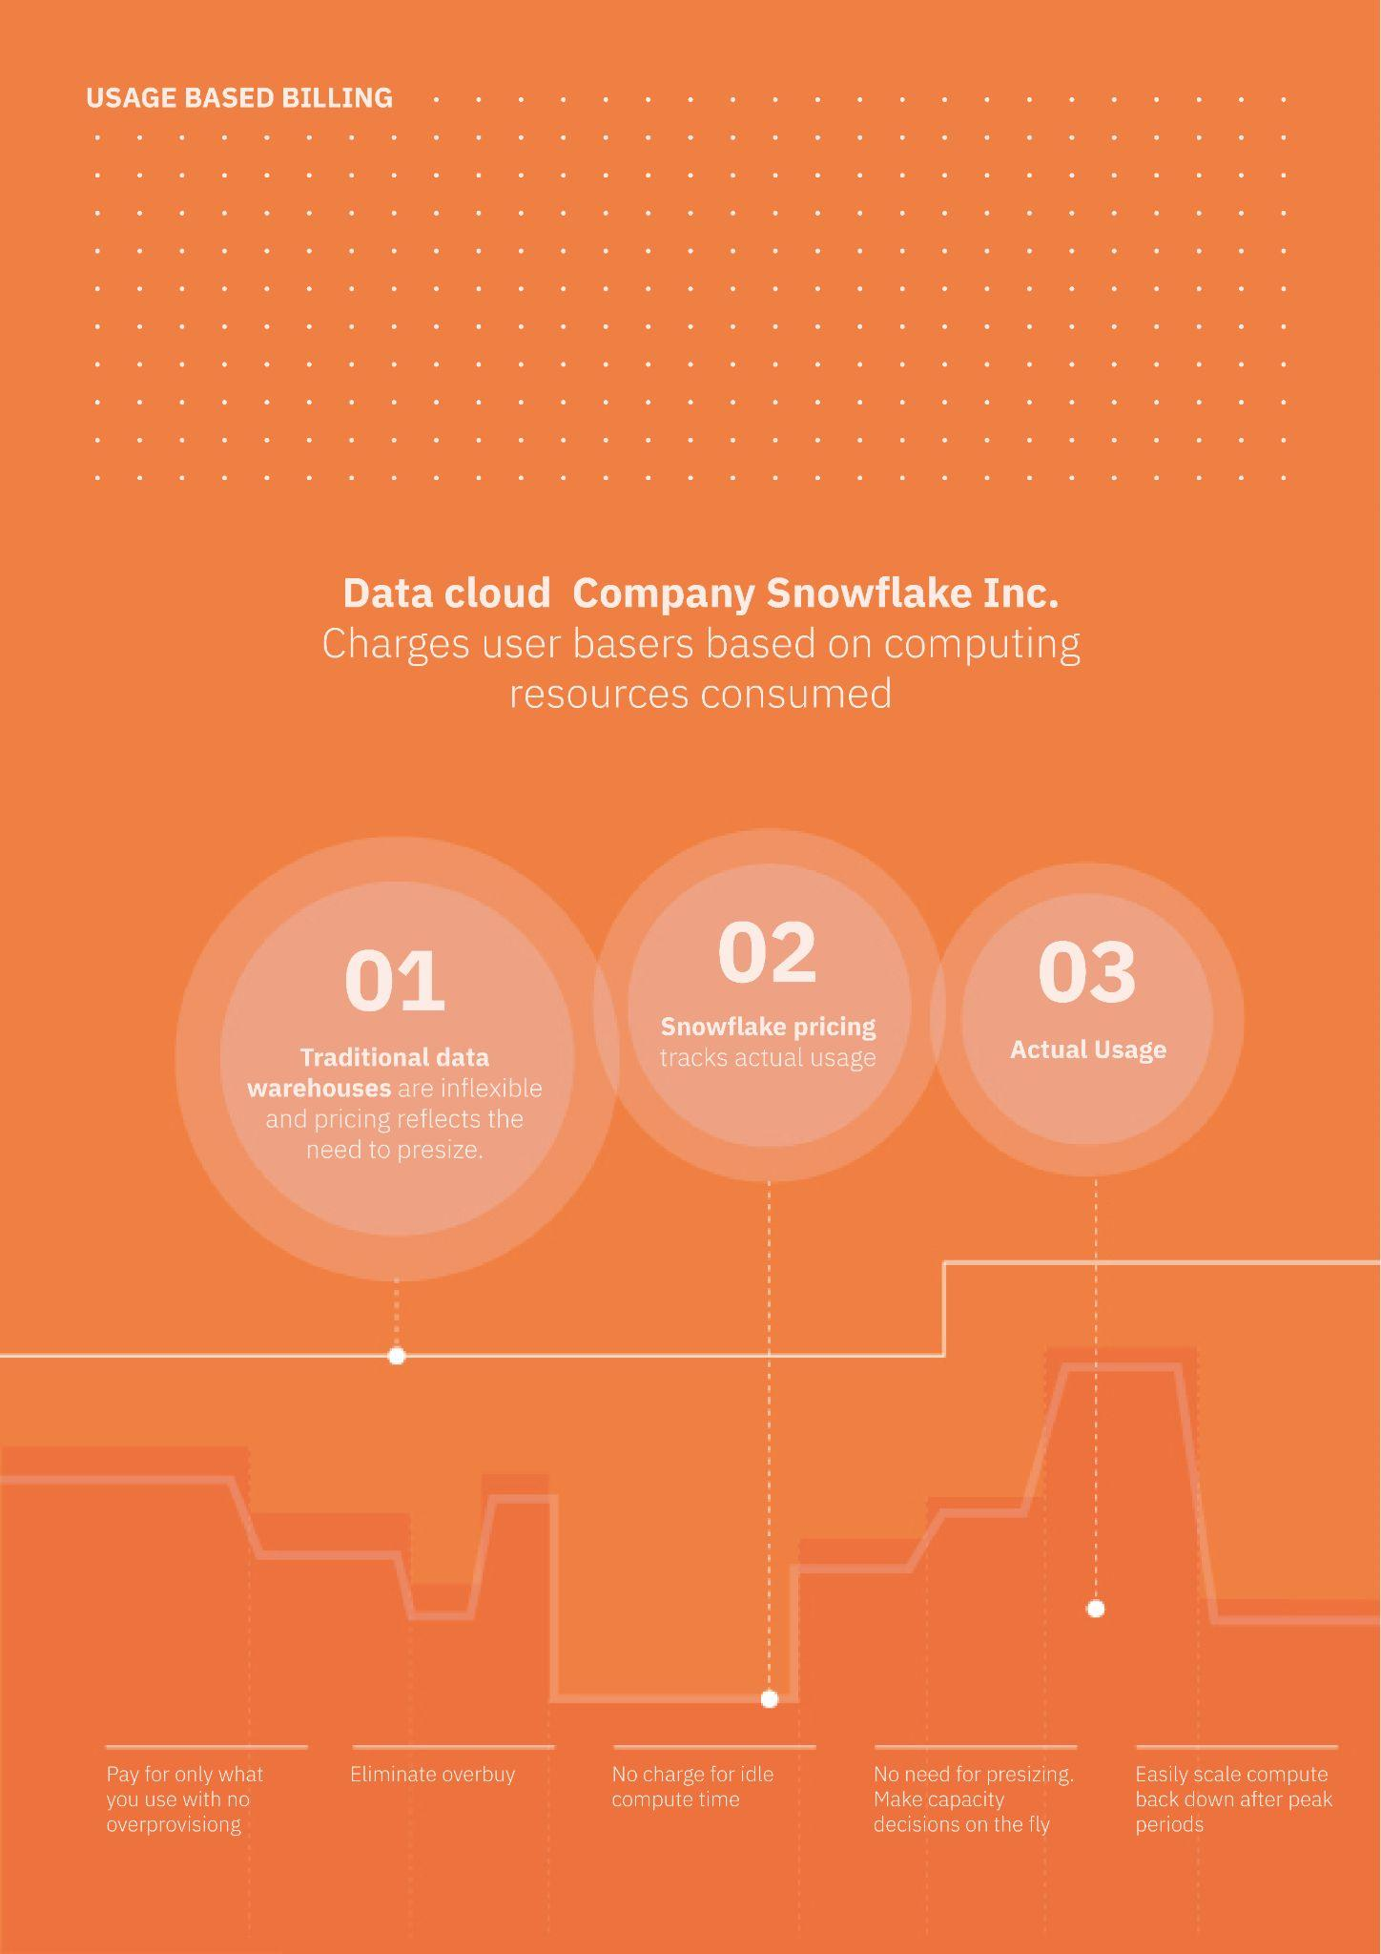

Inner pages
SECTION 4 : What is usage-based billing?

Slide 12
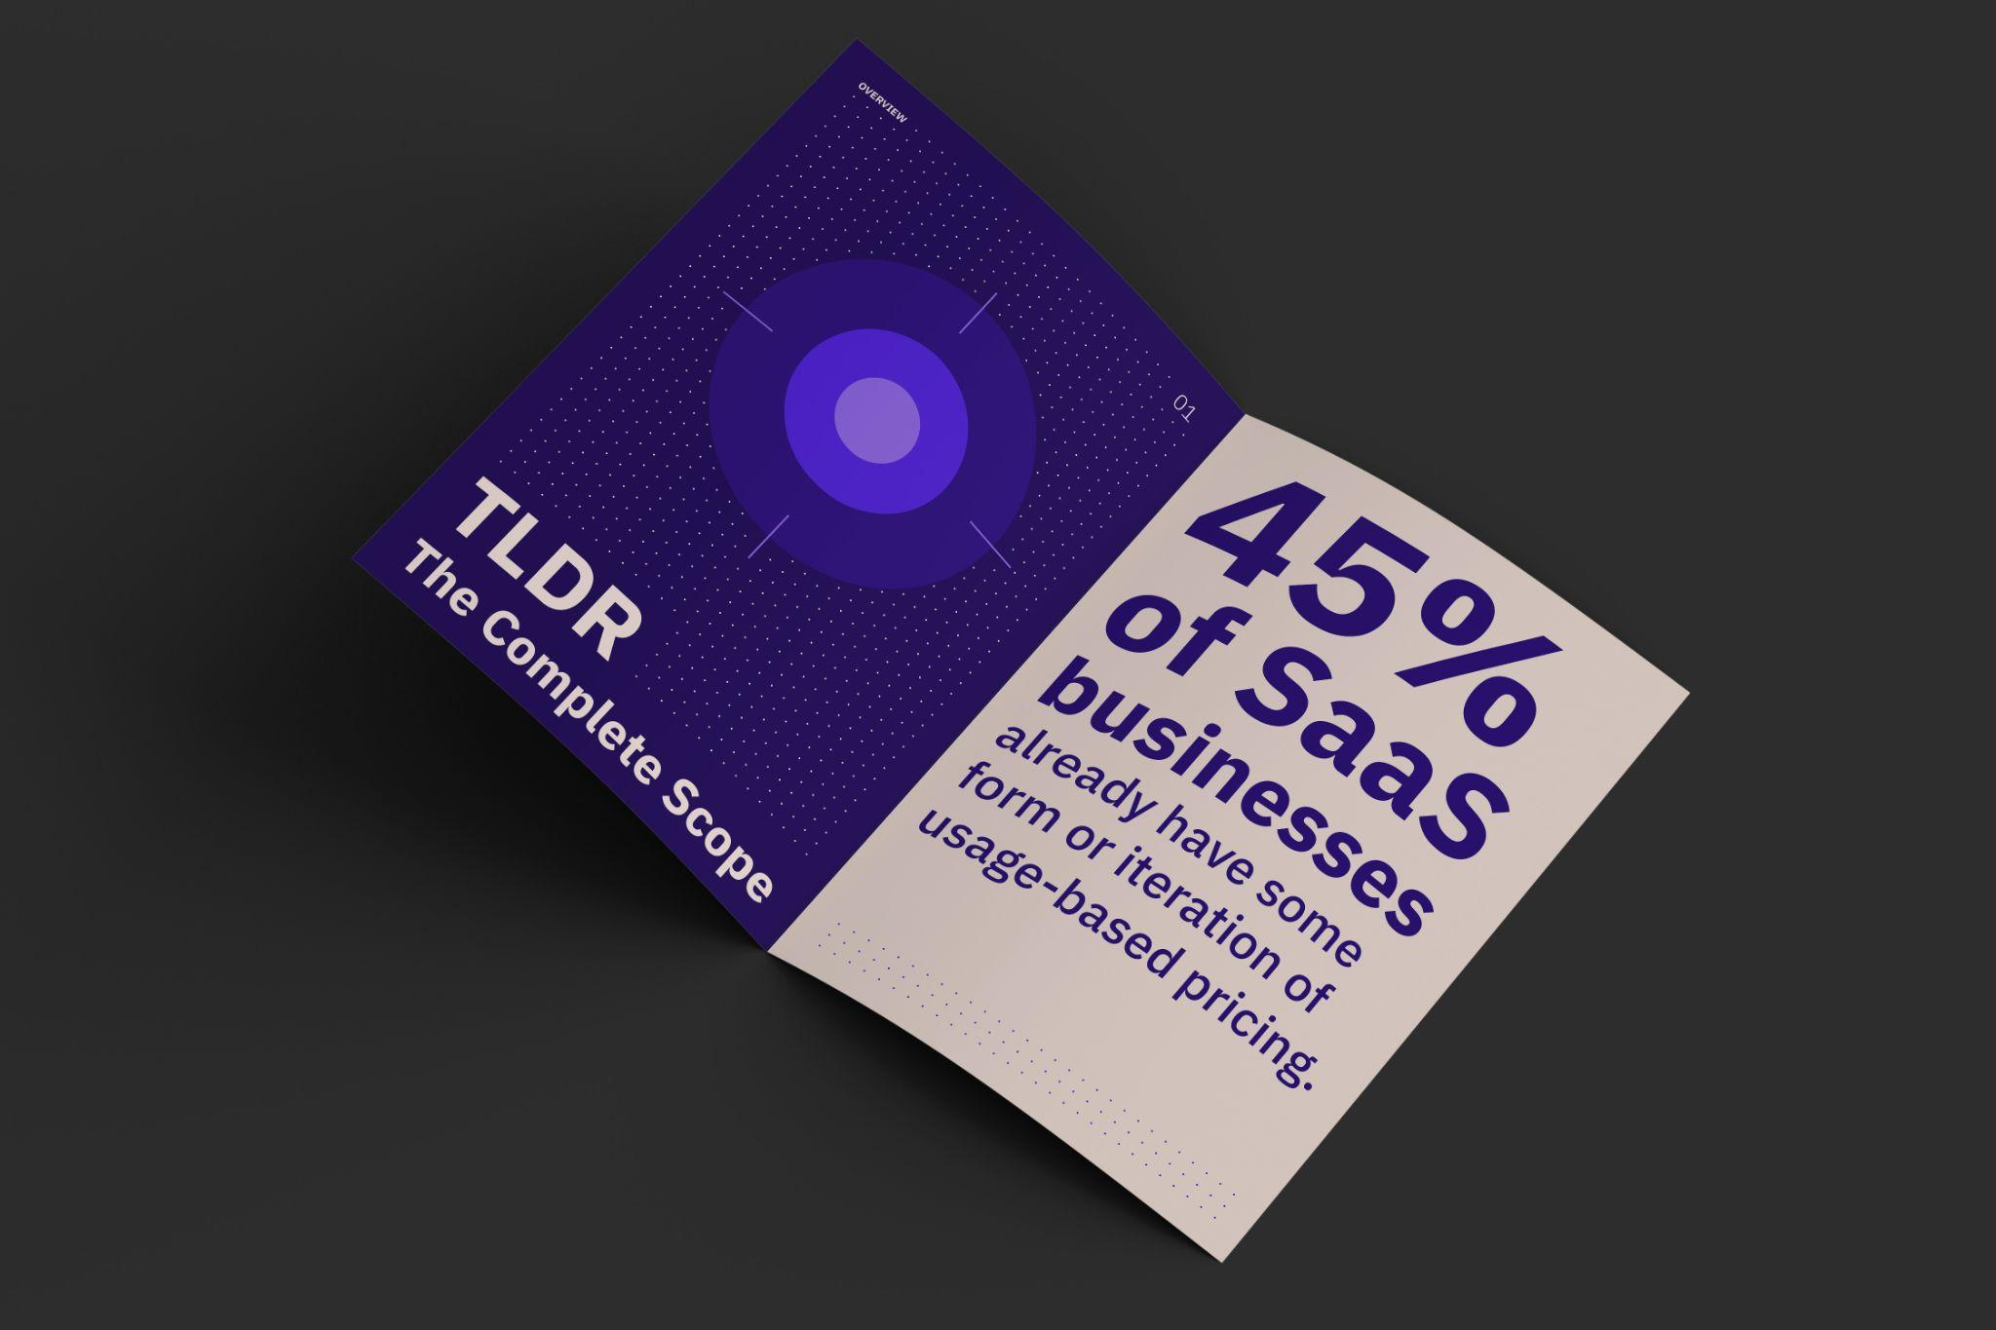
Inner pages

Slide 13

Inner pages

Slide 14
Thank you

